Slide 1
GitHub
Visalam
June 2020

Slide 2

Agenda
GIT windows Installation
GIT Client
GIT GUI
GIT Bash
GIT CMD
Integration of GIT GUI with GitHub
Integration GitHub Desktop with GitHub
Integration of eclipse with GitHub
Basic GIT Commands
Integration of GIT Bash & GIT CMD with GitHub
Visalam
April 2020

Slide 3
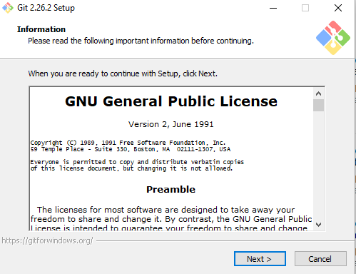
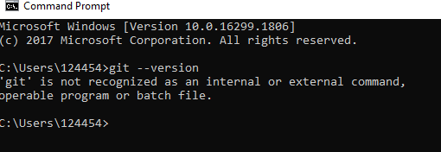
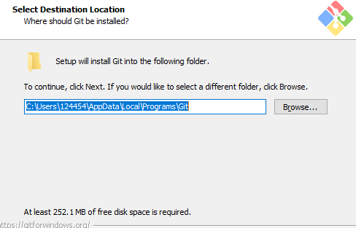
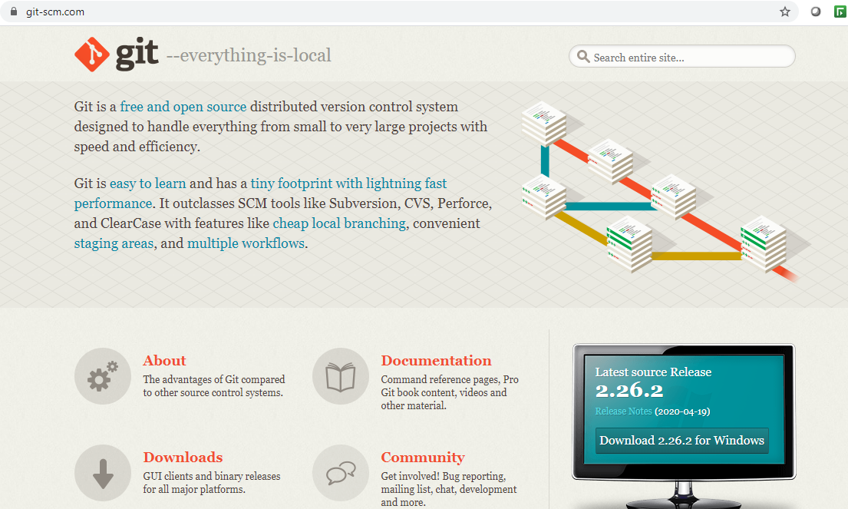
GIT - Windows – Installation steps
Check if Git for windows is already installed
Version is not available and now download Git for windows from https://git-scm.com/ and install.

Slide 4
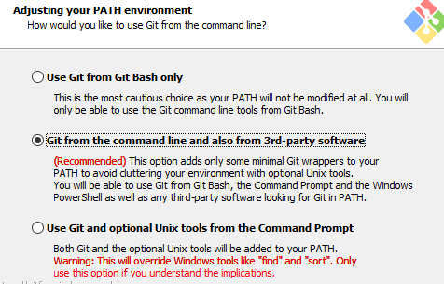
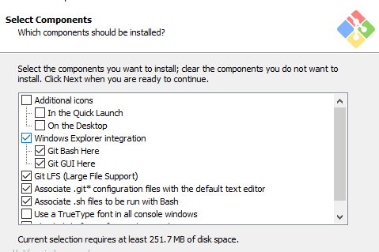
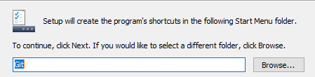
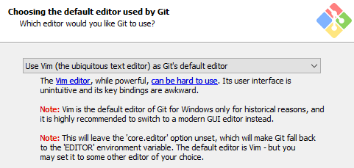
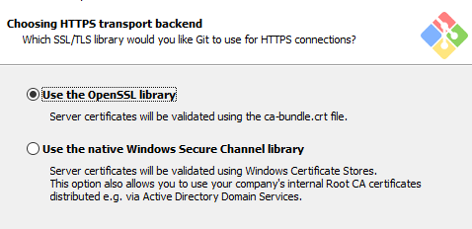
GIT - Windows – Installation steps

Slide 5
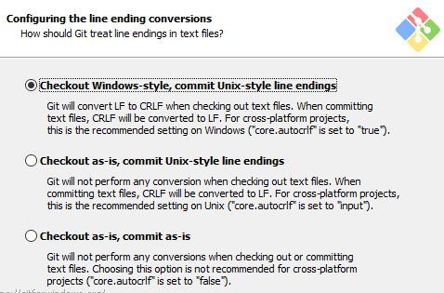
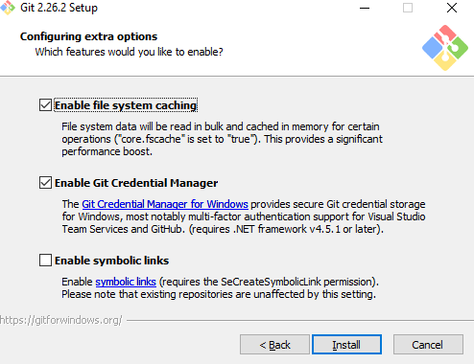
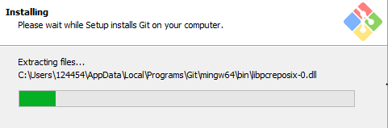
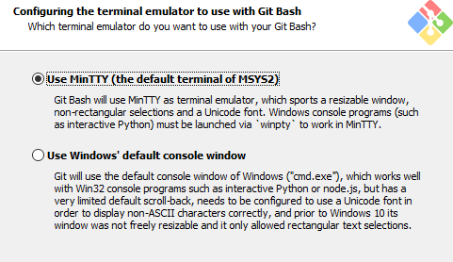
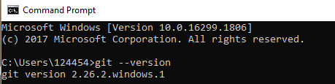
GIT - Windows – Installation steps

Slide 6
Git Client
Git Bash
Git Bash emulates a bash environment on windows
It lets you use all git features in command line plus most of standard unix commands.
Git CMD
Its ike regular Windows command prompt with the command
It lets you use all of Git features through command line.
Git GUI
Graphical User Interface letting you use Git without touching command line.
It is an alternative among other Git clients

Slide 7
Git GUI
GITGUI Use case
Login to GITGUI
Create repository and provide the folder path
Create the empty remote repo with same name
Add files in local folder, this is pointed to master folder by default
Once the file is added and it moved towards unstaged area and drag & drop the file to staged area and click on commit
Add remote repository in GITGUI
Click on “push to origin” to make the changes updated on remote repo
Create a new branch in GITGUI
Modify the existing files in local folder path and now the file is moved to unstaged area
Drag & drop the file to staged area and click on commit
Click on “push to origin” to make the changes updated on remote repo
Checkout master branch
Merge new branch in to master branch and push the changes to Remote repo
Delete child branch

Slide 8
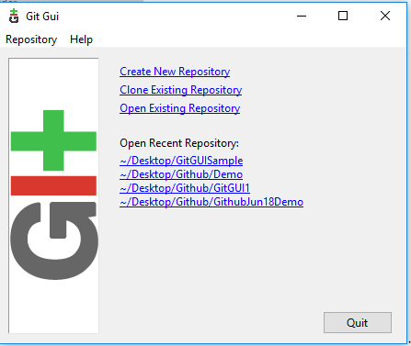
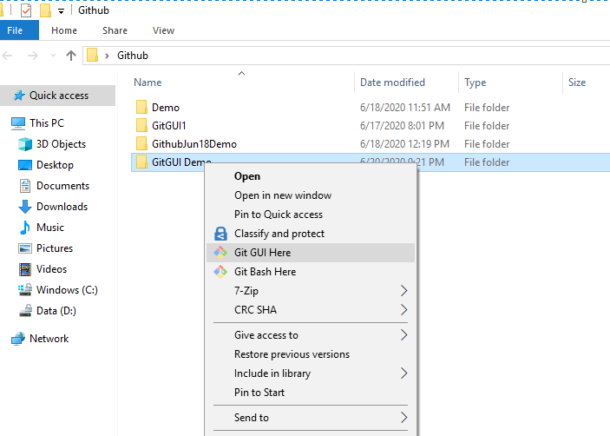
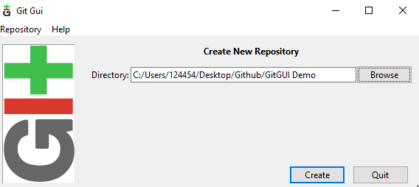
Git GUI
Choosing Create New Repository brings us to the next dialog. Enter the path here and click on “Create”.
To create a repository, first create the folder(Git GUI Demo) you want the project to live under. Next, right click on the folder and choose Git GUI Here. Because there is no git repository in this folder yet, you will be presented with the git gui startup dialog.

Slide 9
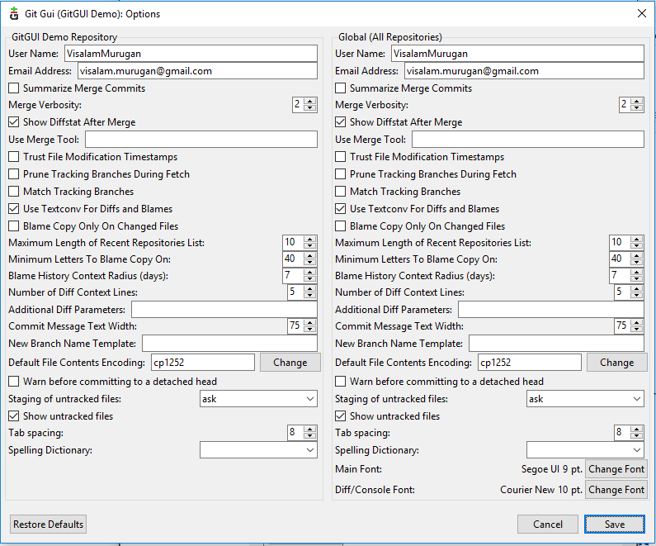
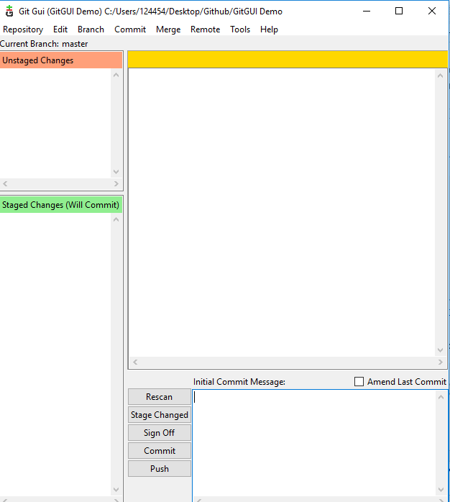
Git GUI
In the options dialog, there are two versions of each preference. On the left side of the dialog are options that you want for this repository only, while the right side contains the global options which apply to all repositories. The defaults for these options are sensible so just fill in the user name and email for now. If you have a favorite font, you may want to set it now as well.
Main Git GUI interface will be listed as below and .git file is created in “GitGUI Demo” folder,
Now that the repository has been set up, you will need to tell git who you are?, so that commit messages will have the correct author. To do this, choose Edit → Options.

Slide 10
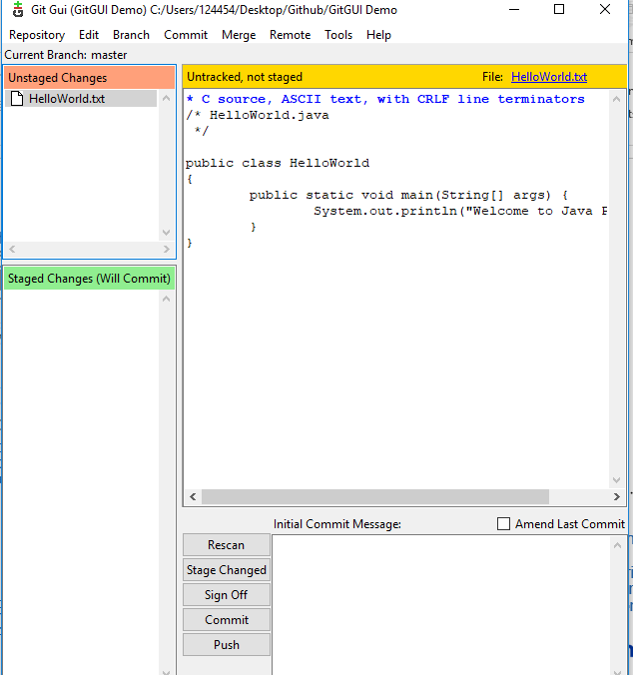
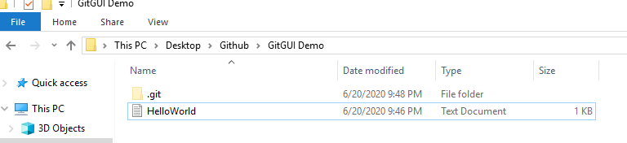
Git GUI
To add the file for committing, click the icon to the left of the filename. The file will be moved from the Unstaged Changes pane to the Staged Changes pane. Now we can add a commit message and commit the change with the Commit button.
Now that the repository has been created, it is time to create something to commit. For this example, I have created the fie called “Helloworld.java”
Clicking the Rescan button in the git gui will cause it to search out new, modified, and deleted files in the directory. In the next screenshot, git gui has found our new file

Slide 11
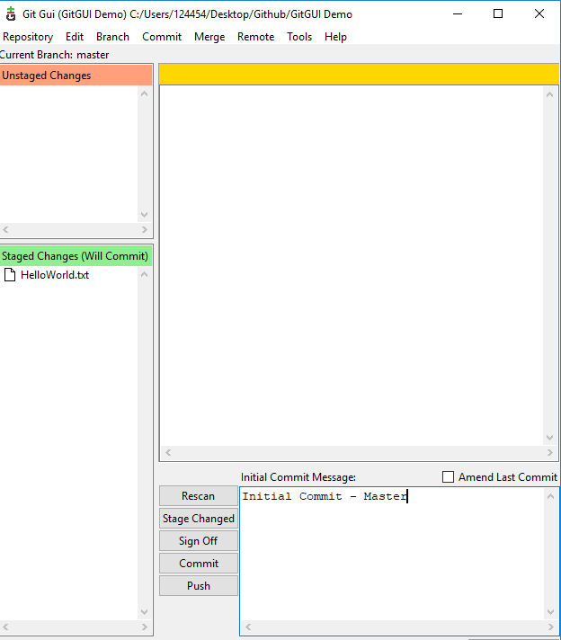
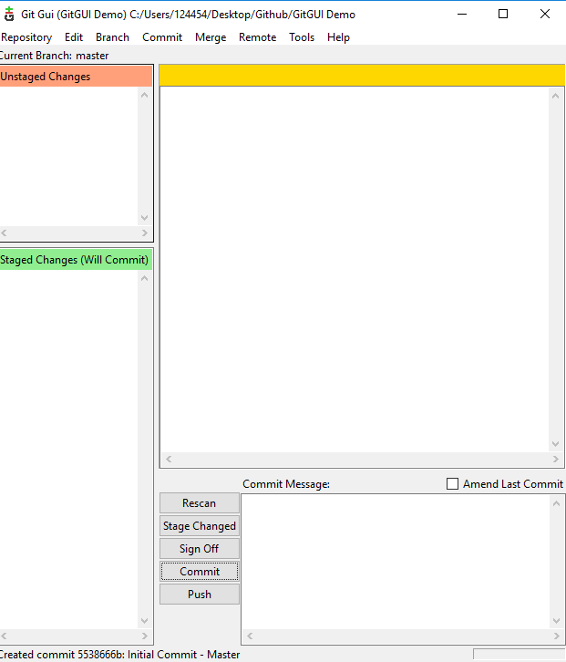
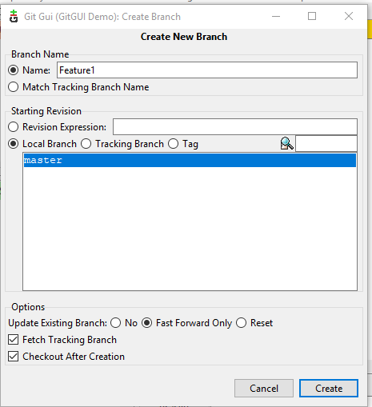
Git GUI
To create a new branch in git gui, choose Branch → Create.
File is committed and unique id is added in bottom of the dialog box

Slide 12
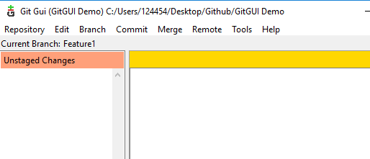
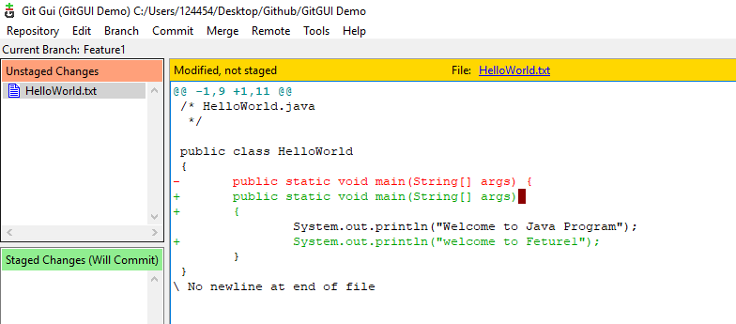
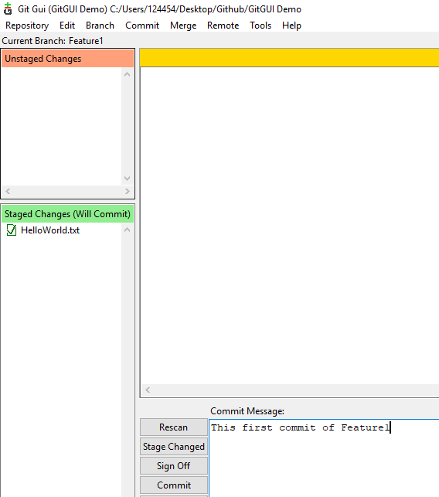
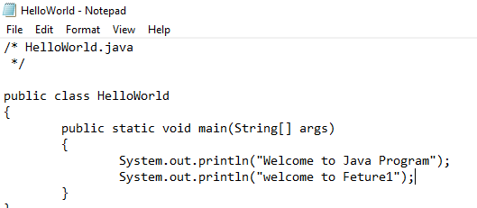
Git GUI
Click on Rescan and modified “HelloWorld.java” file is added in
Unstaged changes.
Move the file from unstaged changes module to staged changes to commit and provide valid commit message and click on commit
Now, new branch “Feature1” is created
In “Feature1” branch – have modified few changes in “HelloWorld.Java” file

Slide 13
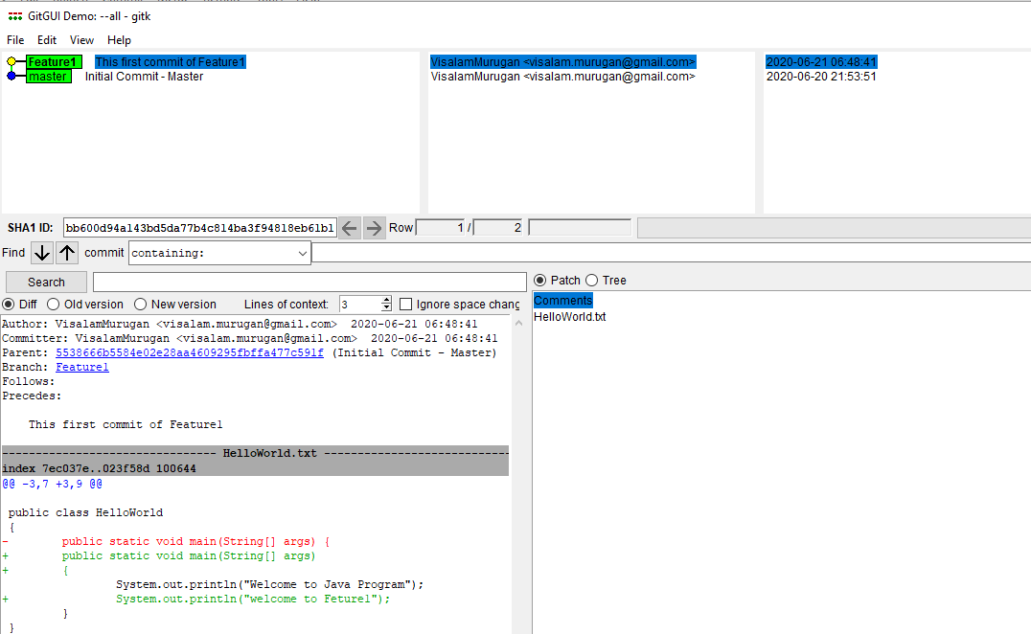
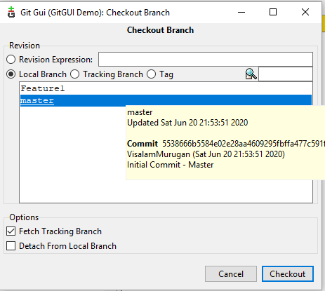
Git GUI
In this example, we identified one serious bug is added and this needs to be fixed in stable branch to reflect in production. In order to make this bug fix on our stable branch, we must first switch back to it. This is done using Branch → Checkout.(master)
Now, choose Repository → Visualize All Branch History, we can see how our history is shaping up.

Slide 14
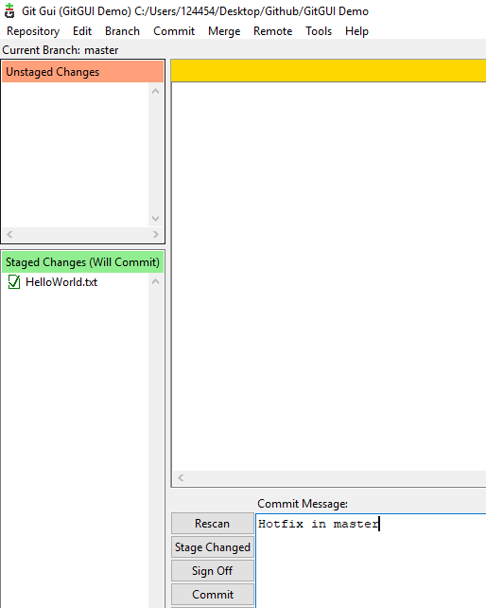
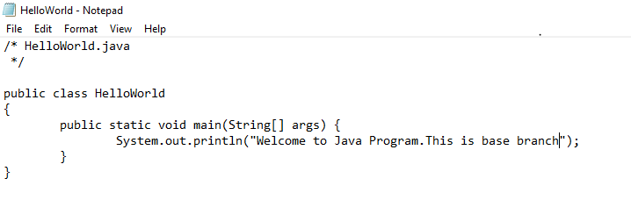
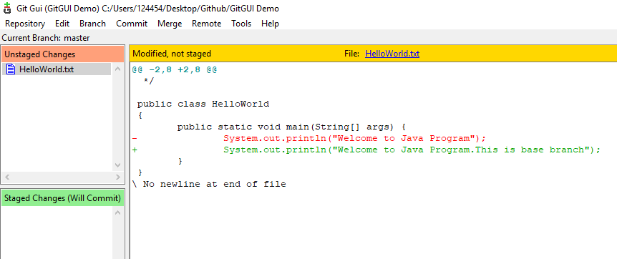

Git GUI
Now, we can fix our major bug by doing changes in “Helloworld.java” program.
Click on Rescan and changes is moved to unstaged changes module
Move the changes to staged changes module and click on commit

Slide 15
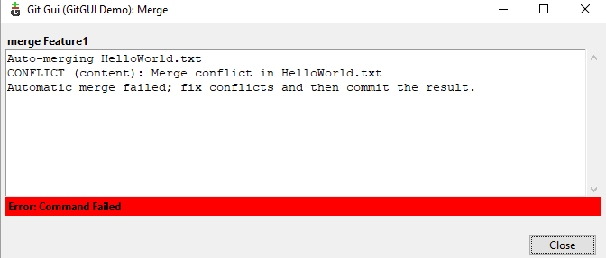
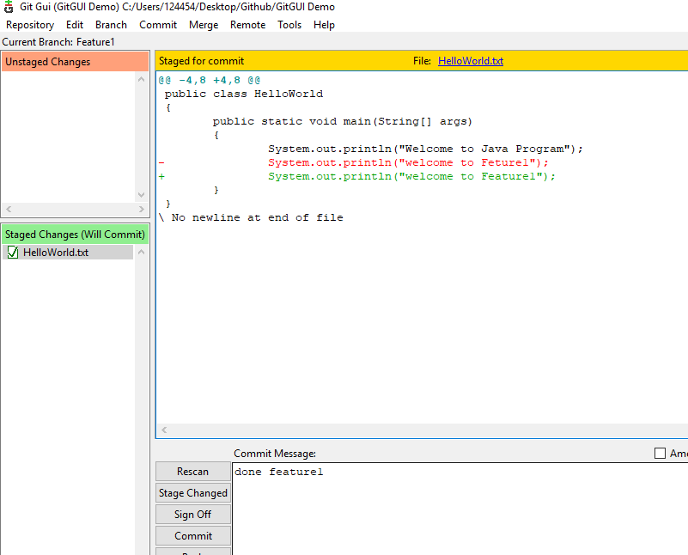
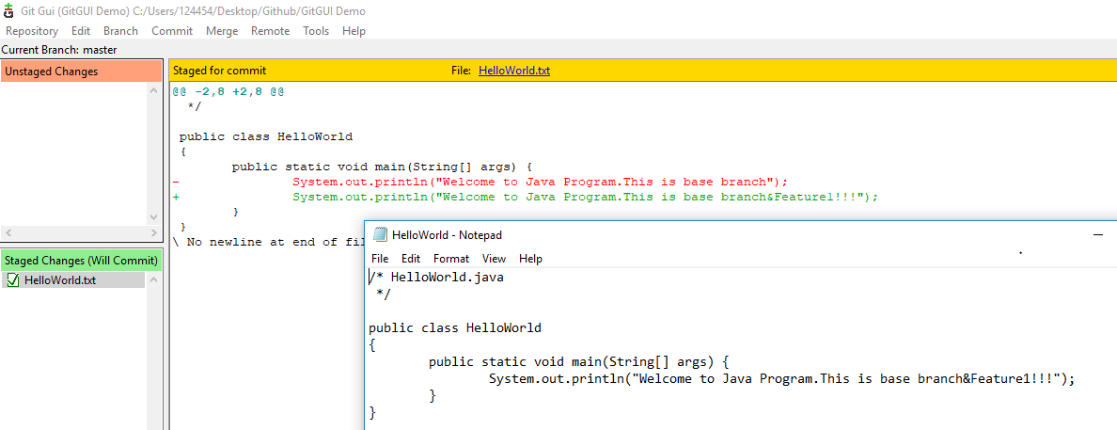
Git GUI
Apply modifications in “Feature 1” branch and commit it
Feature 1 branch is stable enough to be merged into master branch.
To perform the merge, Branch->Checkout->master and then Merge ->Local Merge.
Click on Merge button fix the conflicts
Do the modification manually and resolve the conflicts

Slide 16
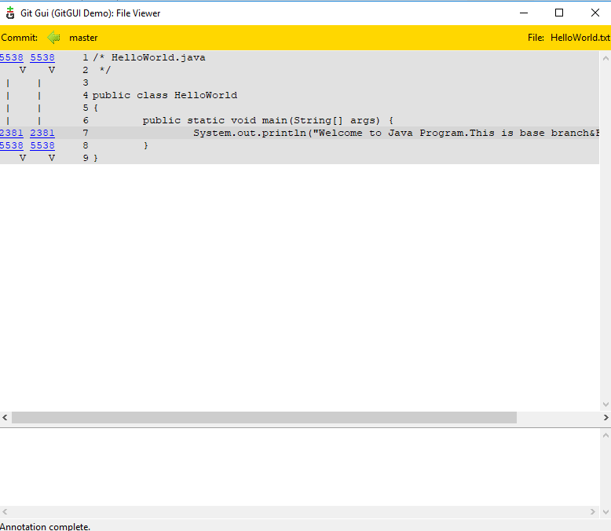
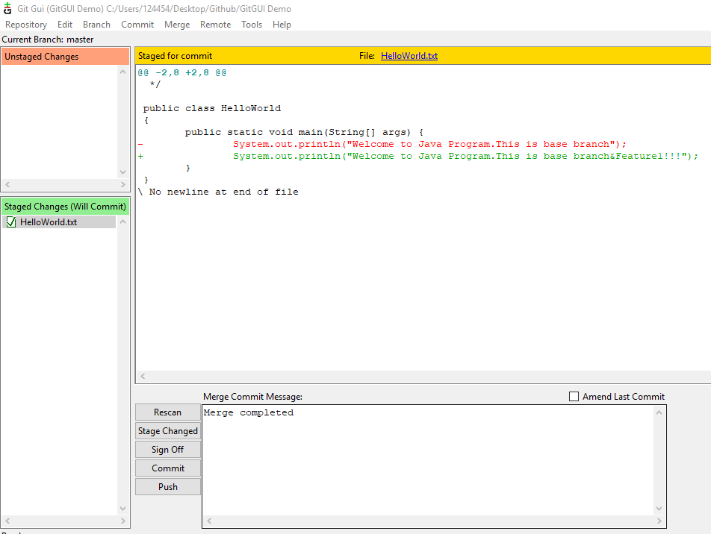
Git GUI
Click on commit->Stage to commit and file is moved to staged changes
Enter the commit message and click on commit button
Click on Repository -> Browse branch files to verify the list of commits applied in branches
Similarly, using Repository ->Visualize all branch history to list down the history of the changes made till now

Slide 17
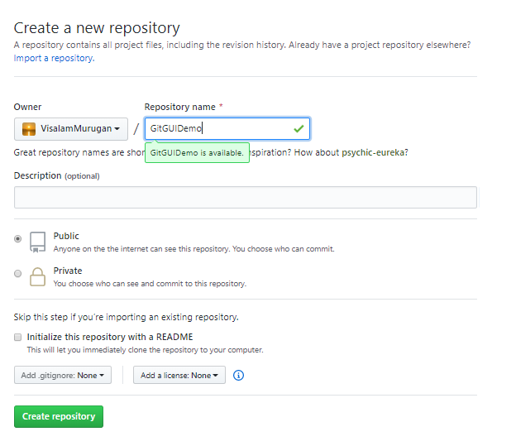
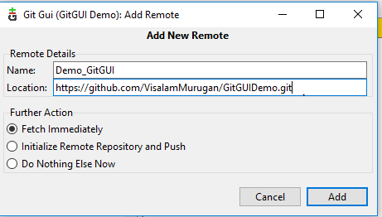
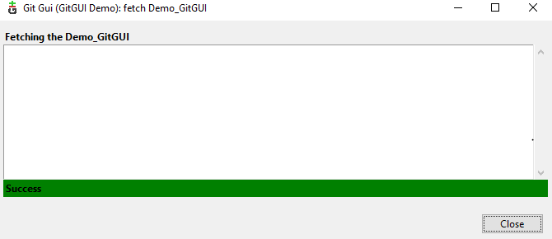
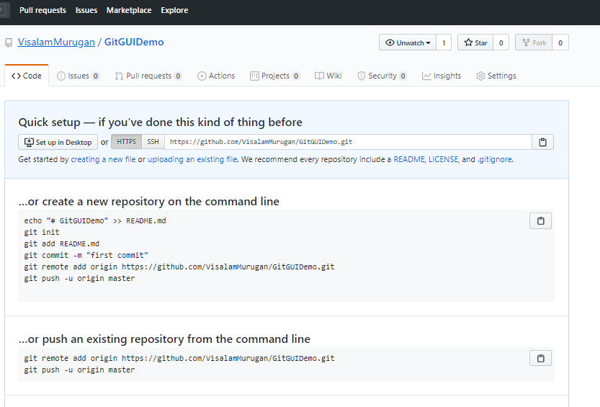
Git GUI
Create repository in Remote server
Click on Create Repository
Add Remote repository by applying Remote->Add new Remote->Add
Connection is established from Local Repo to Remote Repository.

Slide 18
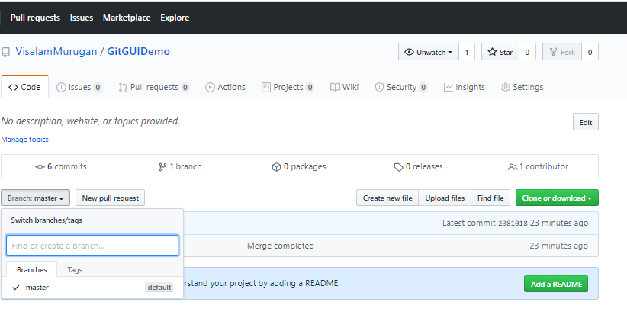
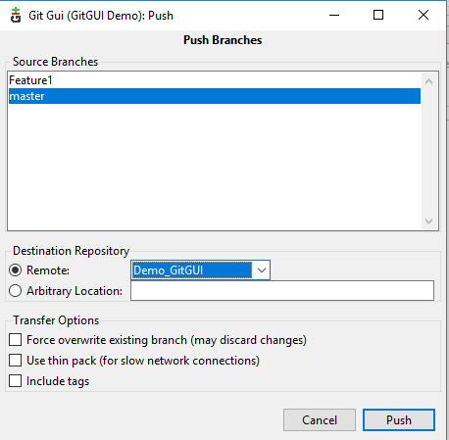
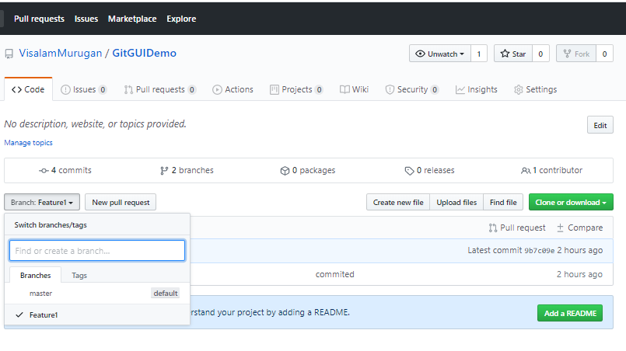
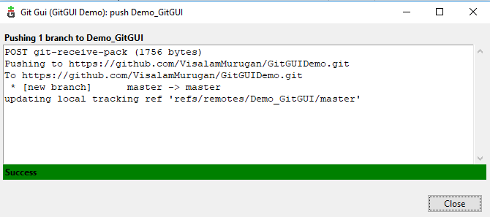
Git GUI
Now, push master files into Remote repo by clicking on Remote->Push
Refresh GitHub Remote repo and master branch is loaded.
Similarly repeat the push operation for “Feature 1 “ branch

Slide 19
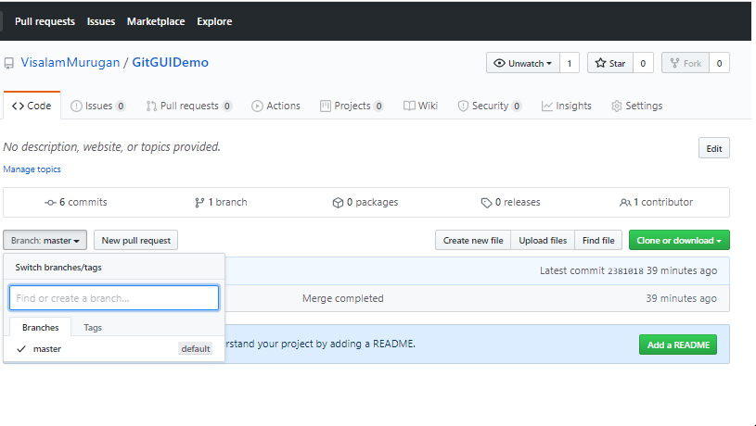
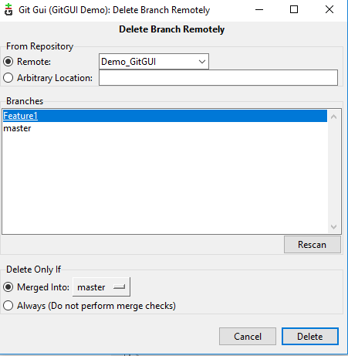
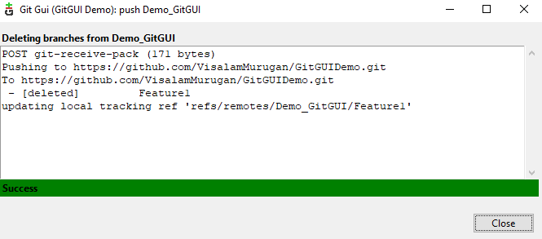
Git GUI
Now, delete “Feature 1” branch. As this is already merged into master branch and remove this branch from remote repo by applying Remote->Delete branch.
Feature1” branch is deleted from both remote Repo
You can also do the similar operation using SSH key instead of https Web URL

Slide 20
GitHub Desktop
GitHub Desktop is a tool that allows you to interact with GitHub from the desktop. With this new application, you can work easier without having to depend on your browser
The installation of GitHub Desktop is as simple as any other Windows application installation.
Open a browser.
Visit desktop.github.com.
Click Download for Windows (64bit).
When prompted, click Run.
Allow the installation to download and install.
Once the installation completes, GitHub Desktop will launch.
Signing in
sign in with your existing GitHub credentials. If you don't already have a GitHub login, head over to the signup page and create a new (free) account. Once you successfully sign in, you are ready to start using GitHub Desktop

Slide 21
GitHub Desktop
Use case
Create empty Remote repository in https://github.com
Clone repository in to local Github DESKTOP
Add the file in local folder path and do commit(this happens in master)
External Text editor : You can set up a default text editor. File ->Options->Integrations, External editor is listed in Repository->Open in Notepad++
Create a new branch Branch->New BRanch
Navigate to local path folder by clicking on Repository->Shows in explorer
1)Add changes in existing file 2)Create new file
The Changes view shows changes you've made to files in your current branch but haven't committed to your local repository.
The History view shows the previous commits on the current branch of your repository.
Perform commit operation
You can view the history from View->history option
Select the master and then "new branch" and push the changes to be added in to remote repository Repository->Push
Now the "New branch" is stable and do the merge into master Branch->Merge into current Branch
Once Merge operation is completed Push the latest merged version in to Remote Repo by Repository ->Push
"New branch" changes are added in Remote repository
Delete the "New Branch" from local(Branch->Delete Branch) and also select the checkbox for remote repo to delete it
Set up Account mail: File->options->Accounts

Slide 22
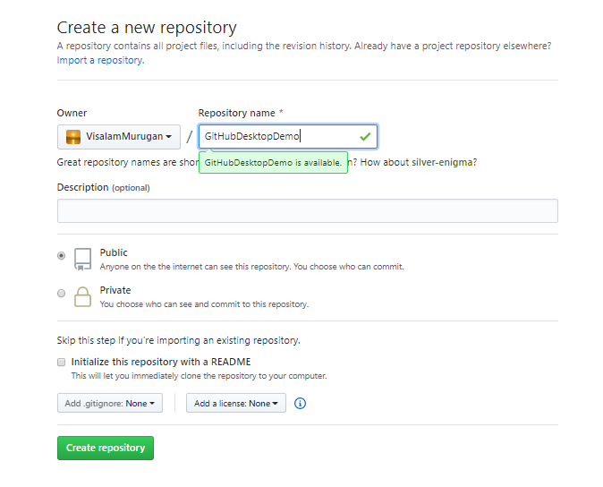


GitHub Desktop
New Repository “GitHubDesktopDemo” has been created.
Clone the Remote Repo in GitHub Desktop
Create a empty repository in GitHub free website and click on create repository

Slide 23


GitHub Desktop
At the bottom, you'll also notice a box with "Summary" and "Description" text boxes and a Commit to master button. This is where you'll commit new changes. The Commit button lets you know which branch you're committing your changes to.
Entered the commit message and click on commit.
Added “Helloworld.java” in “GitHubDesktopDemo” local repo folder
In the left sidebar have Changes and History views.
The Changes view shows changes you've made to files in your current branch but haven't committed to your local repository.
The History view shows the previous commits on the current branch of your repository.

Slide 24



GitHub Desktop
You can access the repository on GitHub.com from within GitHub Desktop. In the file menu, click Repository, then click View on GitHub. This will take you directly to the repository in your default browser.
Now the branch is available within local repo. To publish the repository, you'll "push" it to GitHub, which makes it available on GitHub.com as well.(Repository->Push).Validate the master branch is added in GitHub remote repo.

Slide 25




GitHub Desktop
You can set up a default text editor. File ->Options->Integrations
GitHub account is set up in File ->Options->Accounts
Once you are configured external editor and that will be listed in Repository menu.
You can also raise the issue using Repository->Create issue on GitHub

Slide 26



GitHub Desktop
Click on “Create new branch”
You can navigate to respective local folder by clicking on Repositories->Shows in Explorer
At the top of the app, switch to the branch that you want to base the new branch on by clicking the Current Branch and choosing it from the list.

Slide 27




GitHub Desktop
Apply commit to save the changes
You can see the history by clicking on View->History
Adding one more file index.html

Slide 28


GitHub Desktop
Now changes “Release V1.0” are available only in local repo. Click on Repository ->Push.
Changes are added into Remote repo
Now Release V1.0 branch is stable and merge the branch in to master
For that, select the current branch as master and then Branch ->Merge into current branch

Slide 29


GitHub Desktop
Now Release V1.0 branch changes are added into master
Now, Repository->Push option, move the changes into GitHub Remote Repo.
Merged changes are added in GitHub Remote Repo.

Slide 30



GitHub Desktop
Delete the branch “Release V1.0” from GitHub Remote repo.
Now, repository is removed from remote and not from local. Apply Branch->Delete to remove the branch from local

Slide 31
Basic GIT Commands
git init initializes a brand new Git repository and begins tracking an existing directory. It adds a hidden subfolder within the existing directory that houses the internal data structure required for version control.
git clone creates a local copy of a project that already exists remotely. The clone includes all the project’s files, history, and branches.
git add stages a change. Git tracks changes to a developer’s codebase, but it’s necessary to stage and take a snapshot of the changes to include them in the project’s history. This command performs staging, the first part of that two-step process. Any changes that are staged will become a part of the next snapshot and a part of the project’s history. Staging and committing separately gives developers complete control over the history of their project without changing how they code and work.
git commit saves the snapshot to the project history and completes the change-tracking process. In short, a commit functions like taking a photo. Anything that’s been staged with git add will become a part of the snapshot with git commit.

Slide 32
Basic GIT Commands
git status shows the status of changes as untracked, modified, or staged.
git branch shows the branches being worked on locally.
git merge merges lines of development together. This command is typically used to combine changes made on two distinct branches. For example, a developer would merge when they want to combine changes from a feature branch into the master branch for deployment.
git pull updates the local line of development with updates from its remote counterpart. Developers use this command if a teammate has made commits to a branch on a remote, and they would like to reflect those changes in their local environment.
git push updates the remote repository with any commits made locally to a branch.

Slide 33
GIT Commands with Example(add/modify files in master)
Check if git is installed in your local machine using below command
git version
Use git init command adds a hidden subfolder(.git) within the existing directory that houses the internal data structure required for version control
git init
Check the current status changes as untracked, modified, or staged using below command
git status
Add new file
dir>test.txt
git status
Right click on the folder and open with GIT Bash,now new command prompt screen is open and enter
git status
Data present in Command prompt and Git Bash window are similar.Exit from command prompt and keep using GIT Bash as its very handy and simpleUse below commands to update the “test.txt” changes remotely.
git add test.txt
git status
git commit –m “Added file test.txt”
git status

Slide 34
GIT Commands with Example(add/modify files in master)
Now verify the changes by using status command(Two files to be committed (test.txt (modified) and index.html(newly added))
git status
Use below commands to update the changes in local repository
git add *.* / git add . (. (dot) add all the files )
git commit - m “added index.html | modified test.txt”
Apply status command to confirm if "nothing to be committed" at this state.
git status
Go to Github account
Add remote repository in git by applying below commands
git remote add origin https://github.com/VisalamMurugan/GitMyCommandsProject.git
Apply push command & credentials and changes are added in remote repo
git push –u origin master
git config --global user. email “yourGithubeMail”
git config –global user.name “yourGithubusername”
Open test.txt file and modify the content manually and also add new index.html
.dir>index.html
https://github.com - sign in my account
Create Remote repository in GitHub

Slide 35

GIT Commands with Example(add/modify files in master)
Enter below git commands
git version (Validate the git version is installed)
git init (It adds a hidden subfolder(.git) within the existing directory that houses the internal data structure required for version control)
git status (shows the status of changes as untracked, modified, or staged)
Add new file dir>test.txt and then git status

Slide 36


GIT Commands with Example
Right click on my folder and select “GIT Bash here” property
New GIT Bash command screen is open and entered git status
Data present in Command prompt and Git Bash window are similar.
Exit from command prompt and keep using GIT Bash as its very handy and simple.

Slide 37




GIT Commands with Example
Add new index.html dir>index.html
git Status – Two files to be committed (test.txt (modified) and index.html(newly added)
Validate below commands
git add test.txt
git status
git commit –m “Added file test.txt”
git status
Open test.txt file and modify the content manually
Current test.txt file:
Modified test.txt file:

Slide 38




GIT Commands with Example
git add *.* / git add . (. (dot) add all the files )
git commit - m “added index.html | modified test.txt”
git Status – Nothing to be committed
Now, add this to remote repository.
Go to https://github.com and signin my account
Create a project/Repository
Git repository is created

Slide 39


GIT Commands with Example
Now files are pushed in to Remote GitHub account
git remote add origin https://github.com/VisalamMurugan/GitMyCommandsProject.git
git push –u origin master
Add your github account username and password
git config --global user.email “yourGithubeMail”
git config –global user.name “yourGithubusername”

Slide 40
GIT commands – Create & Merge Branch
Create a new branch
Checkout Branch
Add new file and check the status
Perform commit
git add .
git commit –m “Added sample.txt”
git status
Apply Push command to add the “New Branch” in to Remote repository
git push –u origin “NewBranchName”
Check if master branch have the “sample.txt” file(Not be listed)
git checkout master
Perform merge and push operation to reflect changes in master
git merge “NewBranchName”
git push –u origin master
Master and New Branches are sync, so delete new branch
git branch –d “NewBranchName” (This delete new branch from local)
git push origin –delete “NewBranchName” (This deletes new branch from GitHub online repo)
git branch “NewBranchName”
git checkout “NewBranchName”
git status
touch sample.txt

Slide 41




GIT commands – Create & Merge Branch
Remote Github Repository “GitMyCommandsProject”
Open the local folder using Git Bash
Create a new branch git branch “NewBranchName”
Checkout Branch git checkout “NewBranchName”
Add new file touch sample.txt and check the status git status

Slide 42



GIT commands – Create & Merge Branch
Apply git status
Perform commit
git add .
git commit –m “Added sample.txt”
git status
New branch is not added in remote repository and apply push action to add the branch in remote repository
git push –u origin “NewBranchName”

Slide 43




GIT commands – Create & Merge Branch
Now new branch is added in remote repository with sample.txt.But this file is not yet added in “master”
MyNewBranch:
Master:
Validate using this command if master have the “sample.txt” file
git checkout master
Perform merge and push operation to list out the new changes in master
git merge “NewBranchName”

Slide 44


GIT commands – Create & Merge Branch
Now,sample.text file is not added in master as push action is not performed
Master:
git push –u origin master
Verify if remote GitHub repository (GitMyCommandsProject) have same set of files in master and New Branch
Master:
MyNewBranch:

Slide 45



GIT commands – Create & Merge Branch
New branch is not needed now & delete it from local and Online repository
git branch -d “NewBranchName” (This delete new branch from local)
git push origin --delete “NewBranchName” (This deletes new branch from GitHub online repo)

Slide 46


GIT Commands (Log and Help)
git log – share all the related information that we have done so far
git –help (shows all list of sub commands available in Git)

Slide 47

How To Add GitHub project to Eclipse
Create GitHub Account and sign in
Start a project=create a repository
Start Eclipse
Go to Perspective->Git Repositories and click on Add Git Repo
Create a project in Eclipse(with same name or diff as Git Repo)
Do a right click on project>Team>Share>Add to Git Repo
Commit and Push the project to the repo
Commit and Push every changes to the repo

Slide 48



How To Add GitHub project to Eclipse
Now select the “Git” in Toolbar availability and click on apply & close
GIT icon is added in Tool bar
An eclipse perspective is the name given to an initial collection and arrangement of views and an editor area. The default perspective is called java.
We need to change the perspective from Java to GIT ,in order to that Window->Perspective->Customize Perspective and select “Git”

Slide 49


How To Add GitHub project to Eclipse
Now, new menu is added in Menu bar with the name of “GIT”
Goto Window->Perspective->Customize Perspective->Menu visibility and check “Git”->click on Apply and Close

Slide 50



How To Add GitHub project to Eclipse
“EclipseGitIntegrationDemo” remote repo is created
Create a new Repository in Github.com

Slide 51



How To Add GitHub project to Eclipse
Create a new Repository in Github.com
In our case,we have already created GIT Repository ,so click on “Clone a Git Repository and add the clone to this view icon”
Provide GitHub link from remote GitHub repository and copy the URL and paste it in Clone GIT Repository dialog box
After enter the URL,other fields like host, repository path is updated automatically.
Enter the Github account username and password and click on “Next”
Add an existing local repo to this view
Clone a GIT Repository and add the clone to this view
Create a new GIT Repository and add it to this view

Slide 52




How To Add GitHub project to Eclipse
Click on “Next” in Branch selection dialog box.
Configure the local storage location for “EclipseGitIntegrationDemo” and click on “Finish” button
“EclipseGitIntegrationDemo” repository is configured in Eclipse IDE.
Right click on ““EclipseGitIntegrationDemo” repository and select “Import Projects”

Slide 53




How To Add GitHub project to Eclipse
Enter “Import Source” and click on Finish
Project is added in eclipse IDE
Add a new file “Helloworld.java” in Remote repo
Click on “Pull changes from upstream in to current branch ”
Now “Helloworld.Java” is added in eclipse.

Slide 54



How To Add GitHub project to Eclipse
Create a new branch by clicking on “Check out branch,tag or reference ” or right click on Git Repository branches to perform create branch.
Now “ReleaseV1.0” branch is created and added in Git Local Repo.
Modify few changes in “HelloWorld.Java” & click on commit

Slide 55




How To Add GitHub project to Eclipse
Now “Release V1.0” branch is stable and it can be merged into master “
Click on “Merge”
Identified “Merge conflicts” in HelloWorld.java program.
Do the merge operation manually and click on “Commit”

Slide 56



How To Add GitHub project to Eclipse
Now push the changes from Local to remote repo by right clicking on “Push to origin”
Now selected branch(master) data is synchronized with GitHub

Slide 57



How To Add GitHub project to Eclipse
Merged changes are added in remote Repo for master branch
Now,”Release V1.0” branch is merged with “master” .So “Release V1.0” is no more required.
Branch is deleted from locally
Note: We were not added “Release V1.0” branch in remote repo. So it is not available in central repo.

Slide 58
Thank You
Visalam
GitHub

